Slide 1
Forecasting Solar Power Ramp Events Using Machine Learning Classification Techniques
Mohamed Abuella
Prof. Badrul Chowdhury
Energy Production and Infrastructure Center
Department of Electrical and Computer Engineering
University of North Carolina at Charlotte
S19:Grid Impact of Distributed Generation
Date: Thursday, 28th June

Slide 2
Results and Evaluation
Definition of Solar Power Ramp Events
Presentation Layout
Potential Applications
Methodology

Slide 3
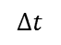
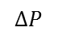
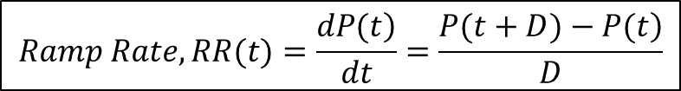
Solar Power Ramp Rates
Solar power ramp rate (RR) is the change of solar power during a certain time interval.
$$Ramp Rate, RR(t)=\frac{\left.dP(t\right)}{dt}=\frac{\left.P(t+D)−P(t\right)}{D}$$
$$ΔP$$
where P(t) is the solar power of the target hour, it can also be its forecast F(t); D is the time duration for which the ramp rate is determined.
$$Δt$$
For the illustrated cloudy day below:
Ramp rate, $\frac{ΔP}{Δt}$ = $\frac{0.2−0.85}{12:00−11:00}=−0.65 \left(−65\%\right) ramp down of its normal capacity, (pu/hr)$
Ramp rate, $\frac{ΔP}{Δt}$ = $\frac{0.48−0.1}{14:00−13:00}=+0.38 \left(+38\%\right) ramp up of its normal capacity, (pu/hr)$
Some ramps are with low rates, while others with high rates.
Ramp Events During a Cloudy Day
3

Slide 4
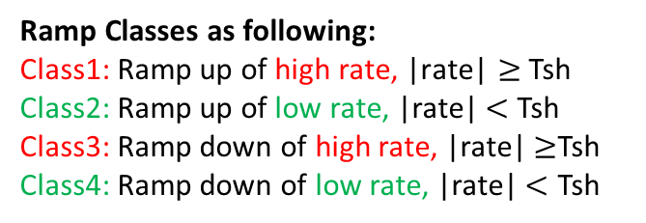
Solar Power Ramp Rates
Classes of Solar Ramp Events
Ramp Classes as following:
Class1: Ramp up of high rate, $\text{|}\text{rate}\text{|}≥$ Tsh
Class2: Ramp up of low rate, |rate|$<$ Tsh
Class3: Ramp down of high rate, |rate|$≥$Tsh
Class4: Ramp down of low rate, |rate|$<$ Tsh
4

Slide 5
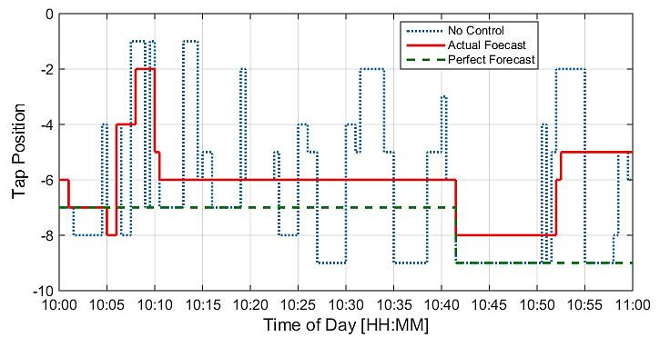
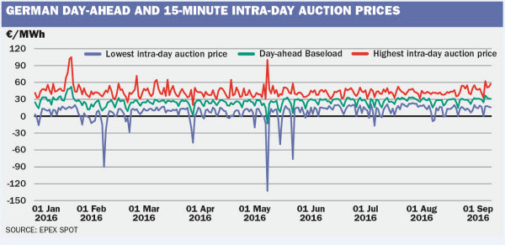
Potential Applications
Using Machine learning classification techniques to forecast PV solar power ramp events, which can be implemented several applications in distribution and transmission system.
Distribution level:
There are applications that rely on ramp event forecasts, such as:
Optimizing the operation of voltage regulation equipment;
Control mechanism of charging and discharging the energy storage systems.
Optimizing the Transformer's Tap Changer position sequences using the solar forecast
Whereas, in the bulk or the transmission level:
Forecasts of ramp events can be used in the trading decisions, and dispatching the operating reserve;
Managing the limits of the ramp rates for reliable and stable operation of electric power systems that have a high-level integrations of renewables.
EPEX: European power exchange spot trading
5

Slide 6
Methodology
Classification Models
The classification models that have been implemented for solar power ramp events.
Naive Bayes;
Linear Discriminant Analysis (LDA);
k-Nearest Neighbors (kNN);
Decision Tree (DT);
Logistic Regression (Log. Reg);
Random Forests (RF);
Support Vector Machines (SVM)
Artificial Neural Network (ANN)
Block diagram of PV solar power ramp events forecasting models
6

Slide 7
Methodology
Combined Forecasting Models
Random Forest (RF) is chosen to be the ensemble learning method for combining the various models’ outcomes.
F_{comb}=W_{A}*M_{A}+ W_{B}*M_{B} + W_{C}*M_{C} ….+ W_{N}*M_{N}
where W_{A} is an assigned weight for an outcome of model (A)
Individual PV Solar Power Ramp Events Forecasting Models
Naive Bayes
LDA
kNN
Ensemble Learning (RF) for Combining of Forecasts
DT
Combined Forecasts
Log. Reg
RF
SVM
ANN
Weather Data
Diagram of combining the different forecasts
7

Slide 8
Methodology
Features:
Weather Variables
No. | Variable Name
1 | Cloud Water Content
2 | Cloud Ice Content
3 | Cloud Cover
4 | 2-m Temperature
5 | Relative Humidity
6 | 10m-U Wind
7 | 10m-V Wind
8 | Surface Pressure
9 | Surface solar radiation down
10 | Surface thermal radiation
11 | Top net solar radiation
12 | Total precipitation
13 | Heat Index
14 | Polar form of wind
Features for classification models are including:
Weather variables,
Solar power forecasts,
Ramp rates of those solar power forecasts,
Class labels of those solar power forecasts.
(c)
So, there are 66 available features.
(a) Solar power forecasts, (b) their ramp rates for 2 days, (c) several weather variables
8

Slide 9
Visualization
Methodology
Data projection onto PC1 and PC2:
Threshold=0.4pu/hr
Class | Class1 | Class2 | Class3 | Class 4 | Total
Samples | 131 | 1290 | 31 | 2376 | 3828
1) All 14 weather variables
2) All 30 Features (add solar power forecasts)
3) All 50 Features (add ramp rates of forecasts)
4) All 66 Features (add class labels of forecasts)
9

Slide 10
Visualization
Methodology
Data projection onto PC1 and PC2:
Threshold=0.4pu/hr
For clarity, low-rate classes (2&4) become as a one class, class3: ➔
Class | Class1 | Class2 | Class3 | Total
Samples | 131 | 31 | 3666 | 3828
1) All 14 weather variables
2) All 30 Features (add solar power forecasts)
3) All 50 Features (add ramp rates of forecasts)
4) All 66 Features (add class labels of forecasts)
10

Slide 11
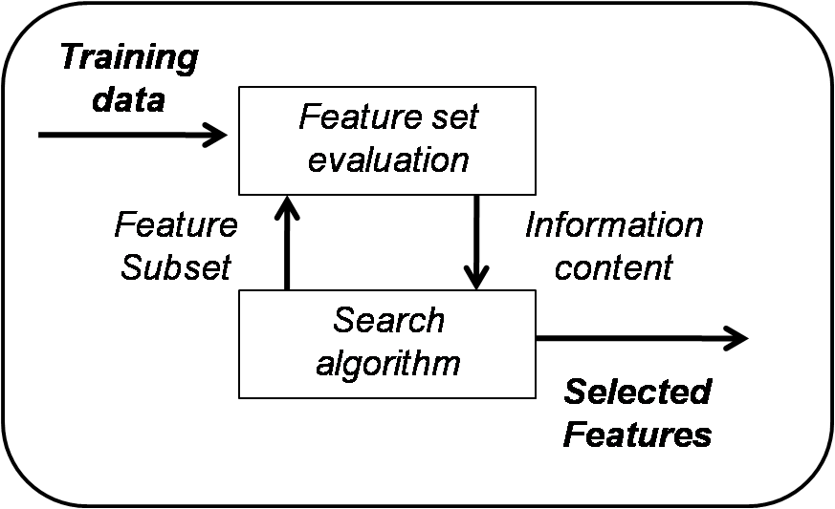
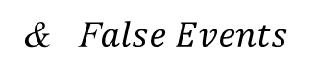
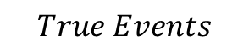
Methodology
Features Selection:
Objective: Increase the true events, Decrease the false events.
Greedy Search - Wrapping Approach:
$$True Events$$
& F$alse Events$
Pick up a feature from the available features set;
Run the model with this feature;
Score the model, by using the following score: Max(Diff. index), where Diff. index is the difference between true and false ramp events;
Add another feature to the selected features;
Repeat steps 2 and 3;
Choose subset of features with the best score, remove the selected from the available features;
Repeat steps 1 to 6;
If there is no longer any feature to select, Stop.
The wrapping approach has a feedback which informs about the performance of the model with the selected features.
Consider all possible combinations of the available features.
Mlle Bouaguel Waad "On Feature Selection Methods for Credit Scoring." (2015). LARODEC, ISG, University of Tunis
11

Slide 12
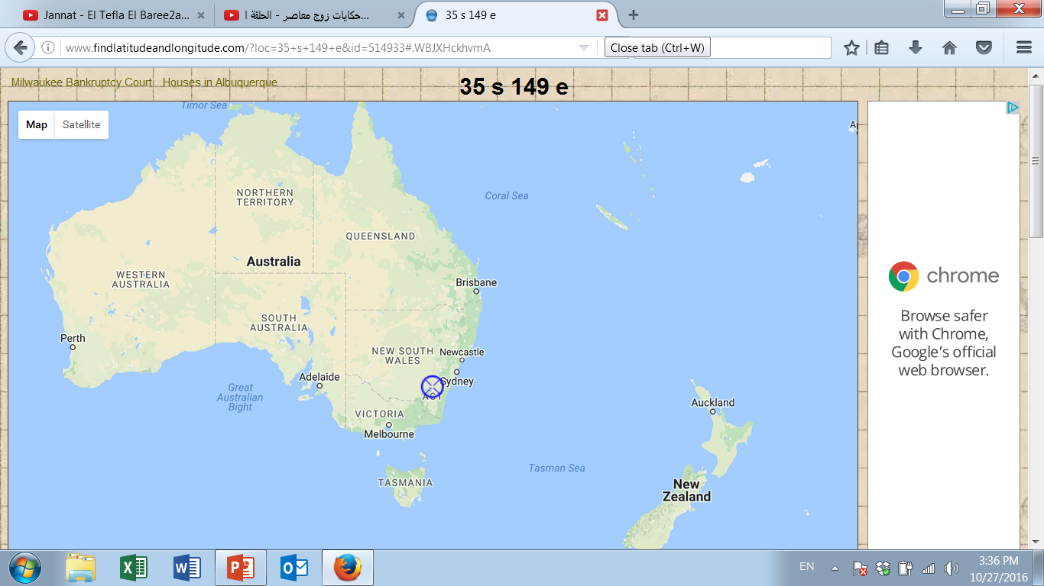
Case Study
Hour-ahead Solar Power Ramp Events Forecasting
Data Description:
PV solar system is near Canberra, Australia, consisting of 8 panels, its nominal power of (1560W), and panel orientation 38° clockwise from the north, with panel tilt (of 36°). The historical observed solar power data are normalized to the rated capacity (i.e., 1560W).
Weather Variables
No. | Variable Name
1 | Cloud Water Content
2 | Cloud Ice Content
3 | Surface Pressure
4 | Relative Humidity
5 | Cloud Cover
6 | 10m-U Wind
7 | 10m-V Wind
8 | 2-m Temperature
9 | Surface solar radiation down
10 | Surface thermal radiation down
11 | Top net solar radiation
12 | Total precipitation
13 | Heat Index
14 | Polar form of wind
No. | Month | Year
1 | April | 2012
2 | May | 2012
3 | June | 2012
4 | July | 2012
5 | August | 2012
6 | September | 2012
7 | October | 2012
8 | November | 2012
9 | December | 2012
10 | January | 2013
11 | February | 2013
12 | March | 2013
13 | April | 2013
14 | May | 2013
15 | June | 2013
16 | July | 2013
17 | August | 2013
18 | September | 2013
19 | October | 2013
20 | November | 2013
21 | December | 2013
22 | January | 2014
23 | February | 2014
24 | March | 2014
25 | April | 2014
26 | May | 2014
Training
The weather forecast data and the available measured solar power data from April 2012 to May 2014.
Testing
(European Centre for Medium-Range Weather Forecasts)
Weather predictions are produced by the global numerical weather prediction system (ECMWF).
https://crowdanalytix.com/contests/global-energy-forecasting-competition-2014-probabilistic-solar-power-forecasting
http://www.ecmwf.int
12

Slide 13
Case Study
Hour-ahead Solar Power Ramp Events Forecasting
This study presents classification techniques to forecast the solar power ramp events.
The objective of implementing the classification techniques for the solar power ramp events forecasting is to increase the true events and decrease the false events of forecasts of high-rate ramp events.
The moving time window of the rolling forecasts of solar power ramp events is 1 hour (i.e., D, duration=1hr).
The forecasts of solar power ramp events over an entire year are generated and several evaluation metrics are used to assess the forecasts of the ramp events of solar power.
There are 162 high-rate ramp events when threshold (Tsh) =0.4pu/hr.
Classes of solar power ramp events in the case study
Distribution of the classes of solar power ramp events at threshold (Tsh) =0.4pu/hr.
13

Slide 14
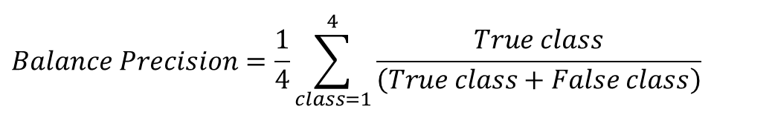
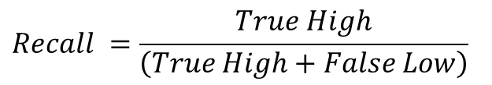
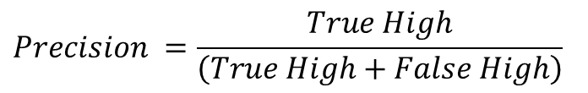
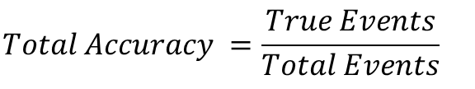
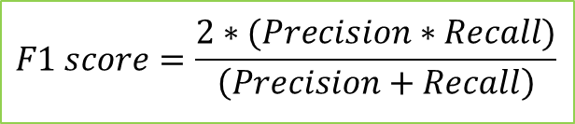
Results and Evaluation
The following evaluation metrics are used to assess the performance of the classification techniques:
Objective: Increase the true events, Decrease the false events.
$$Total Accuracy =\frac{True Events}{Total Events}$$
$$True Events$$
& F$alse Events$
$$Precision =\frac{True High}{\left(True High+False High\right)}$$
$$Recall =\frac{True High}{\left(True High+False Low\right)}$$
$$Balance Precision=\frac{1}{4}\sum_{class=1}^{4}{\frac{True class}{\left(True class+False class\right)}}$$
Confusion matrix of possible cases of solar power ramp events
where High denotes high-rate ramp events and Low refers to low rate ramps; True events are when the events are predicted to belong to the same classes as found in the actual observations, while False is indicated when the events are predicted to be in classes other than those found in the actual observations.
$$F1 score=\frac{2∗(Precision∗Recall)}{\left(Precision+Recall\right)}$$
$$Diff. index=\left(True−False\right) of High Rate Events$$
The most suitable metrics for our application are the Diff. index and the F1 score.
14

Slide 15
Results and Evaluation
(a) The most 12 important features out of 66; (b) selected features and parameters for each model
(a)
(b)
No. | Most Important Features
1 | Cloud water content, NWP output
2 | Cloud cover, NWP output
3 | Top net solar radiation, NWP output
4 | Hour-ahead combined forecasts of solar power
5 | Ramp rates of NWP-driven day-ahead solar power forecasts by ANN
6 | Ramp rates of NWP-driven day-ahead solar power forecasts by SVR
7 | Ramp rates of hour-ahead combined forecasts of solar power
8 | Ramp rates of time-series hour-ahead forecasts of solar power by NARX
9 | Ramp classes of persistence hour-ahead forecasts of solar power
10 | Ramp classes of NWP-drive day-ahead solar power forecasts by ANN
11 | Ramp classes of NWP-driven day-ahead solar power forecasts by SVR
12 | Ramp classes of hour-ahead combined forecasts of solar power
Model | Parameters | Selected Features
Naïve Bayes | Distribution=Normal; distribution parameters are estimated in the training. | 1, 5, 11
LDA | Its coefficients (μ) are fitted in the training. | 1, 2, 3, 6, 9, 10, 12
Decision Tree | Max of splits=15; Min leaf size=1 | 1, 12
kNN | Euclidean distance; k=15 (nearest 15 neighbors) | 1, 4, 6, 7, 8
Logistic Regression | Its coefficients (β) are fitted in the training. | 1, 3, 11, 12
Random Forests | Forest size=100 trees; Min. leaf size=1 | 1, 3, 11, 12
SVM | Kernel= Radial basis function; C=184; gamma=5 | 1, 3, 11, 12
ANN | Hidden layer=1; Neurons=10 | 1, 5, 12
15

Slide 16
Results and Evaluation
Method | Naïve Bayes | LDA | Decision Trees | kNN | Logistic Regression | Random Forest | SVM | ANN | Combined Classifiers
Precision (%) | 62% | 65% | 73% | 68% | 79% | 79% | 77% | 70% | 79%
Recall (%) | 43% | 40% | 38% | 31% | 30% | 43% | 43% | 38% | 50%
Balanced Precision (%) | 75% | 78% | 80% | 78% | 59% | 80% | 80% | 78% | 87%
F1-Score (%) | 51% | 49% | 50% | 43% | 44% | 56% | 55% | 49% | 61%
Diff. Index | 27 | 30 | 38 | 27 | 36 | 51 | 48 | 35 | 60
Solar power ramp events forecasts by the classification techniques of the high-rate ramp events (162 events)
16

Slide 17
Conclusions
This study presents the challenging aspect of ramp forecasting, which is not comparable to studies that detect the ramp events by using historical solar power observations and meteorological measurements.
For a general assessment of the classification model performance for solar power ramp events forecasting, the evaluation metrics that consider the precision and the recall together, such as Diff. Index and F1 score, should be used, in order to properly weigh both the true and the false events of high-rate ramp events.
In the individual classification models, the RF and SVM models yield the most accurate forecasts of solar power ramp events.
In addition, combining the outcomes of the models obtains an improvement of 18% over the best model, and leads to a more robust performance.
The classification techniques (i.e., RF, SVM, and combined classifiers) outperform the solar power forecasts that are used as features to those classification techniques by about 15~40% over the best solar power forecasts, which have Diff. index=42.
17

Slide 18


Thanks for Your Listening
Any Question?
Mohamed Abuella
mabuella@uncc.edu
http://epic.uncc.edu/
Energy Production and Infrastructure Center
University of North Carolina at Charlotte

